Slide 1

INTERNSHIP PROJECT / FULL STACK DEVELOPMENT
VOLT GYM
Website & Enquiry Management System
A responsive website for gym information, training programs, member feedback and visitor enquiries.
INTERNSHIP COMPANY
DEVELOPED BY
ASTGEN SOFTWARES
Aditya Shukla · 0614CS231004
Dileep Rathore · 0614CS231016
TRAIN BEYOND LIMITS
4th Year · Computer Science Department
Pt. Devprabhakar Shastri College of Technology
PROJECT PRESENTATION
GUIDE Ajay Prajapati / HOD Santosh Patel
VOLT GYM / ASTGEN SOFTWARES
01 / 20

Slide 2
02 / PROJECT OVERVIEW
What Is This Website About?
A single place to explore the gym and connect with its team.
Explore the gym and connect with its team.
01
02
03
04
VISITOR
→
PHP API
→
MYSQL
→
ADMIN
DISCOVER
Explores pages
Checks form data
Saves records
Reviews entries
Programs, coaches, gallery and membership options.
ENQUIRE
Visitors can send contact and visit requests.
HTML · CSS · JS
PHP
MYSQL
SESSIONS
MANAGE
Staff can review enquiries and member feedback.
VOLT GYM / ASTGEN SOFTWARES
02 / 20

Slide 3
03 / PROBLEM & PURPOSE
Why Did We Build This Website?
To make gym information easier to find and enquiries easier to manage.
INFORMATION GAP
CONTACT FRICTION
FEEDBACK VISIBILITY
Clear details about services, coaches and plans.
A structured way to request a visit or share goals.
One staff inbox for enquiries and reviews.
OUR SOLUTION
We brought gym details into one responsive website and connected forms to a PHP/MySQL workflow.
VOLT GYM / ASTGEN SOFTWARES
03 / 20

Slide 4

04 / PUBLIC WEBSITE
Homepage & Hero Slider
A strong first impression with clear navigation and calls to action.
NAVIGATION
Links jump to the main sections of the page.
AUTOMATIC SLIDER
The featured background changes on a timer.
CONTROLS
Previous/next buttons and pagination dots let visitors navigate.
HTML: section · div · button · i
CSS: background images
JS: setInterval() · active class
VOLT GYM / ASTGEN SOFTWARES
04 / 20

Slide 5
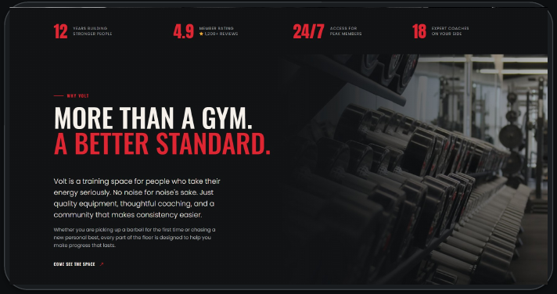
05 / BRAND STORY
About Volt Gym
Short, readable content introduces the training environment and brand purpose.
ABOUT
Explains the gym’s approach to training and consistency.
VISION
Make strength and movement part of everyday life.
MISSION
Pair coaching with a welcoming environment.
HTML: section · h2 · p · div
CSS: layout · typography
VOLT GYM / ASTGEN SOFTWARES
05 / 20

Slide 6
06 / BRAND STORY
Vision & Mission
The gym’s purpose is presented as a quick, easy-to-scan story.
VISION
Make strength, movement and self-respect part of everyday life.
MISSION
Pair coaching with a welcoming space where progress is shared.
DESIGN CLUE
Short text blocks and paired content improve readability.
HTML: headings · paragraphs · containers
CSS: spacing · contrast
VOLT GYM / ASTGEN SOFTWARES
06 / 20

Slide 7
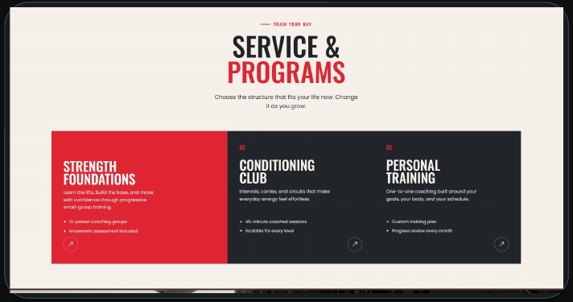
07 / SERVICES
Training Programs
Three pathways help visitors find the kind of training that fits their goals.
STRENGTH FOUNDATIONS
Build lifting fundamentals and confidence.
CONDITIONING CLUB
Intervals, carries and circuits for everyday energy.
PERSONAL TRAINING
One-to-one coaching with a custom plan.
HTML: section · cards · headings
CSS: grid · card styling
VOLT GYM / ASTGEN SOFTWARES
07 / 20

Slide 8
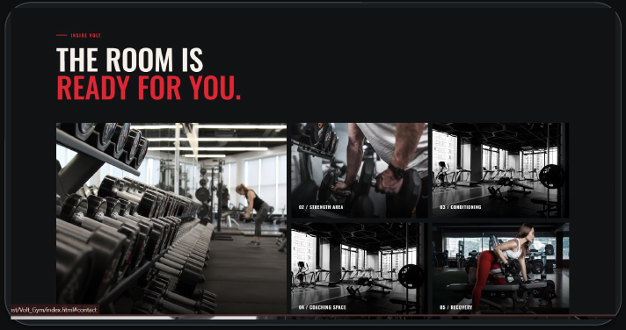
08 / VISUAL EXPLORATION
Gallery & Image Lightbox
Gym photography helps visitors picture the space before they arrive.
GALLERY GRID
One large feature image is balanced by smaller tiles.
SELECTABLE IMAGES
Visitors can open selected photos in a larger view.
INTERACTION
JavaScript handles the lightbox behaviour.
HTML: image containers · controls
CSS: grid · overlay styling
JS: lightbox interaction
VOLT GYM / ASTGEN SOFTWARES
08 / 20

Slide 9
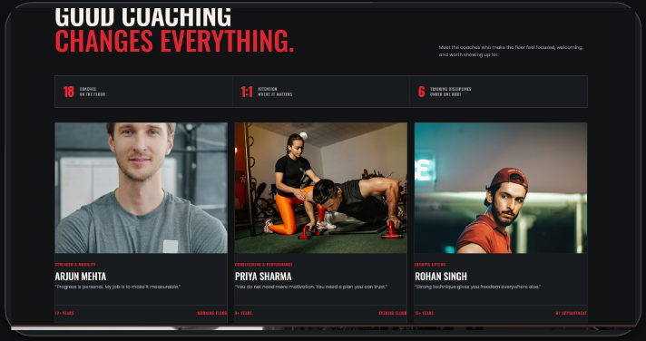
09 / PEOPLE
Coach & Trainer Profiles
Profiles communicate coaching specialisations and trainer identity.
SPECIALISATIONS
Show the coaching discipline for each profile.
EXPERIENCE
Labels and short descriptions add context.
SCOPE NOTE
Profiles are website content, not an admin-managed staff module.
HTML: cards · images · headings
CSS: grid · image treatment
VOLT GYM / ASTGEN SOFTWARES
09 / 20

Slide 10
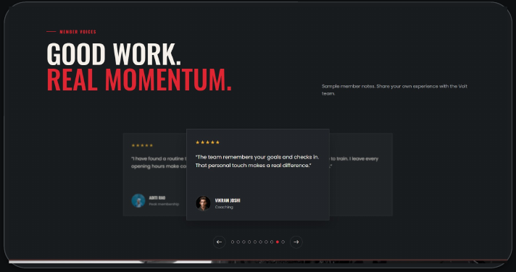
10 / COMMUNITY
Member Reviews & Feedback
Visitors can read member feedback and submit a star-rated review.
REVIEW CAROUSEL
Previous/next controls and pagination navigate quotes.
REVIEW FORM
Collects name, a 1–5 star rating and feedback.
BACKEND LINK
Accepted reviews are stored for staff review.
HTML: form · inputs · buttons
CSS: cards · states
JS: carousel · validation
VOLT GYM / ASTGEN SOFTWARES
10 / 20

Slide 11
11 / BACKEND WORKFLOW
Reviews — Backend
From the visitor’s form to a saved review.
01
02
03
04
FORM
→
PHP API
→
PDO + SQL
→
ADMIN INBOX
Name, rating, message
Checks fields and rating range
Prepared insert into MySQL
Staff reviews submission
php/api.php
VALIDATION
PDO PREPARED SQL
MYSQL
Rating is limited to 1–5 stars.
VOLT GYM / ASTGEN SOFTWARES
11 / 20

Slide 12
12 / PLANS & PRICING
Membership Plans
The website presents options clearly; it does not process payments.
ESSENTIAL
PEAK
PERSONAL
₹1,000
₹1,500
₹3,000
/ month
/ month
/ month
+ Full gym access, 06:00–22:00
+ 24/7 full gym access
+ Everything in Peak
+ Changing rooms and recovery area
+ 4 coached classes each month
+ 4 personal training sessions
+ Monthly movement check-in
+ Quarterly goal-setting session
+ Custom training program
HTML: plan cards
CSS: grid · emphasis
NO PAYMENT GATEWAY
VOLT GYM / ASTGEN SOFTWARES
12 / 20

Slide 13
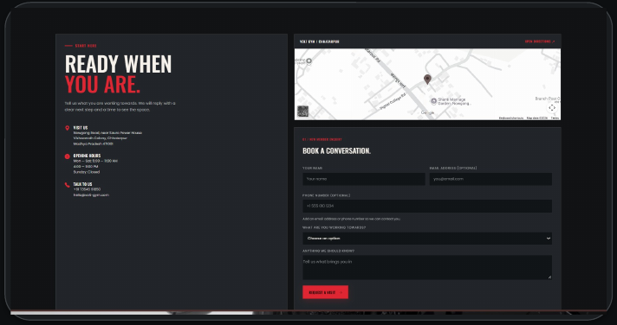
13 / LEAD CAPTURE
Contact & Enquiry Form
Visitors can share contact details and request a visit.
CONTACT DETAILS
Address, opening hours, phone and email are shown together.
FORM FIELDS
Name, contact method, training goal and optional message.
SUBMISSION
The form sends a request to the PHP API.
HTML: form · input · button
JS: form interaction
PHP: api.php
VOLT GYM / ASTGEN SOFTWARES
13 / 20

Slide 14
14 / BACKEND WORKFLOW
Enquiry — Backend
A simple pipeline validates and stores each accepted enquiry.
01
02
03
04
REQUEST
VALIDATE
PERSIST
RESPOND
→
→
→
Form sends submitted data
Check required fields and contact details
PDO prepared insert to MySQL
Return a status and message
POST JSON
PHP VALIDATION
PDO PREPARED SQL
MYSQL
Staff can then review the record in the inbox.
VOLT GYM / ASTGEN SOFTWARES
14 / 20

Slide 15
15 / USER EXPERIENCE
Light/Dark Mode & Responsive Design
JavaScript switches the theme; CSS changes the colours; the choice is saved.
1 THEME BUTTON
JavaScript handles the click and toggles the light-theme class on the page.
2 CSS COLOURS
CSS rules under .light-theme change backgrounds, text, cards and navigation colours.
3 SAVE THE CHOICE
localStorage stores light or dark under volt-theme; the saved theme is applied when the page loads.
4 RESPONSIVE LAYOUT
CSS media queries adjust navigation and content for smaller screens.
JS: CLICK HANDLER
CSS: .light-theme
localStorage
VOLT GYM / ASTGEN SOFTWARES
15 / 20

Slide 16
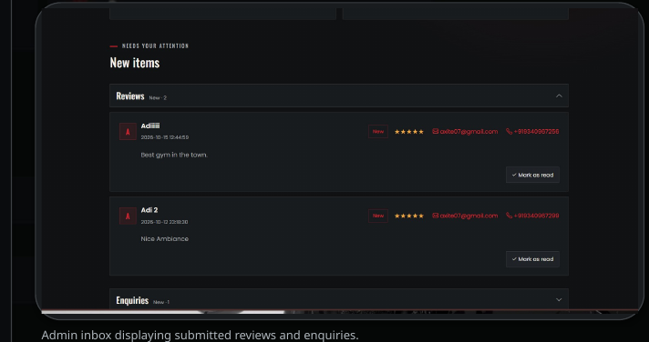
16 / STAFF TOOLS
Admin Dashboard
A staff-only inbox brings enquiries and reviews into one place.
OVERVIEW
Shows total review and enquiry counts.
NEW ITEMS
Incoming submissions are grouped for attention.
READ STATUS
Staff can mark items as read and track reviewed records.
PHP: admin.php
SESSIONS
MYSQL READS
VOLT GYM / ASTGEN SOFTWARES
16 / 20

Slide 17
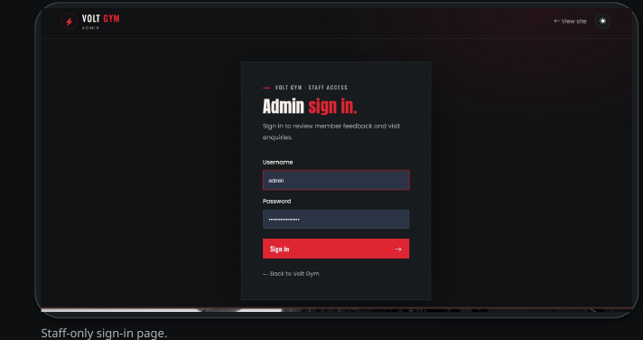
17 / ACCESS CONTROL
Admin Backend & Security
Only authenticated staff should be able to manage submissions.
LOGIN
Checks the entered password against the stored password hash.
SESSION
Session authentication protects dashboard actions.
CSRF PROTECTION
POST actions use a server-validated session token.
SAFER OUTPUT
Output escaping helps prevent injected HTML from being rendered.
password_verify()
PHP SESSION
CSRF TOKEN
VOLT GYM / ASTGEN SOFTWARES
17 / 20

Slide 18
18 / IMPLEMENTATION
Database & Technology Stack
The public interface and the PHP/MySQL backend have separate responsibilities.
inquiries
reviews
admins
admin_read_status
id · name · email · phone
goal · message · created_at
id · name · email · phone
rating · message · created_at
id · username
password_hash · created_at
submission_type · submission_id
read_at
TECH STACK
HTML5
CSS3
Vanilla JS
Bootstrap
Page structure
Layout, themes, effects
Slider, lightbox, interactions
CSS utilities + icons
PHP
MySQL + PDO
XAMPP
GitHub Actions
API + admin dashboard
Persistent data + prepared queries
Local PHP/MySQL setup
Static frontend deployment
VOLT GYM / ASTGEN SOFTWARES
18 / 20

Slide 19
19 / PROJECT LEARNINGS
Challenges & Solutions
Key implementation decisions that connect the interface to real workflows.
FORM INPUTS
Validate required fields, formats, rating range and message length.
DATABASE SAFETY
Use PDO prepared statements instead of joining user input into SQL.
ADMIN ACCESS
Protect the dashboard with password verification, sessions and CSRF checks.
DEPLOYMENT LIMIT
GitHub Pages hosts static files; PHP/MySQL needs a PHP-capable server.
VOLT GYM / ASTGEN SOFTWARES
19 / 20

Slide 20
VOLT GYM / ASTGEN SOFTWARES
THANK YOU
Thank you for your time and consideration.
Website & Enquiry Management System
DEVELOPED BY
Aditya Shukla · 0614CS231004 / Dileep Rathore · 0614CS231016
4th Year · Computer Science Department
TRAIN BEYOND LIMITS
Pt. Devprabhakar Shastri College of Technology
QUESTIONS?
GUIDE Ajay Prajapati / HOD Santosh Patel
VOLT GYM / ASTGEN SOFTWARES
20 / 20

